Slide 1
Drawing Comparisons Between Microbe VOCs and SWD Behavior
Microbe VOCs collected from:
F. faeni in 10% juice
P. agglormeans in 10% juice
F. faeni and P. agglormeans mixed together in 10% juice (both at same relative initial conc/amount)

Slide 2
F. faeni VOCs
P. agglomerans VOCs
Timolol
Carbonic acid, dimethyl ester
1-Butanol
1-Butanol, 3-methyl-
2-Nonanone
Benzene, 1,3-bis(1,1-dimethylethyl)-
Pyrazine, 3-ethyl-2,5-dimethyl-
Bicyclo[2.2.1]heptan-2-ol, 1,7,7-trimethyl-, (1S-endo)-
1-Propanol, 3-(methylthio)-
(-)-Myrtenol
Benzyl alcohol
Phenylethyl Alcohol
3-Cyclohexene-1-ethanol, .beta.,4-dimethyl-
3-Cyclohexene-1-ethanol, .beta.,4-dimethyl-
p-Mentha-1(7),8(10)-dien-9-ol
Eugenol
Disulfide, dimethyl
1-Butanol, 3-methyl-, acetate
1-Butanol
Heptanal
1-Butanol, 3-methyl-
2-Hexenal, (E)-
Acetoin
1-Heptanol
Furfural
1-Hexanol, 2-ethyl-
Benzonitrile
2-Furanmethanol
Mequinol
Benzyl alcohol
Phenylethyl Alcohol
2H-Pyran-2-carboxaldehyde, 5,6-dihydro-
Phenol

Slide 3
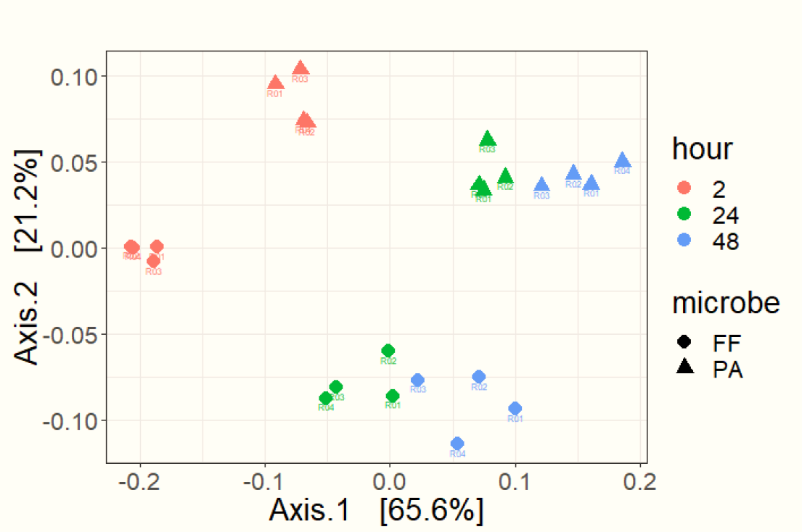
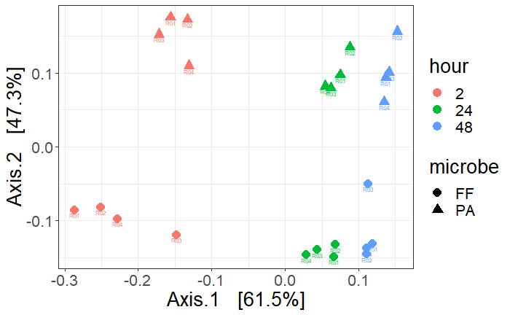
Notes:
Only unique voc’s
On left is visually filtered (faster) vs on right, manually filtered – note: the important part is 3 d vs. 2.5 weeks

Slide 4
Drawing Comparisons Between Microbe VOCs and SWD Behavior
SWD Bioassay data needed
Incubator background VOCs – how incubator ambient affects blanks/controls
VOC transfer from control to blank
VOC transfer from treatment to blank
F. faeni in 10% juice vs. SWD - repellent
P. agglomerans in 10% juice vs. SWD - attractant
F. faeni vs. P. agglomerans in 10% juice in a single cage vs. SWD – is the choice confirmed
F. faeni & P. agglomerans mixed together in 10% juice vs. SWD – dominate microbe? This brings up next questions as to mechanism (pop, priority, metabolites, host, or other)
Notes:
Because odors are probably being absorbed into media
Without total work up, media absorption into blanks and controls is likely neglible.

Slide 5
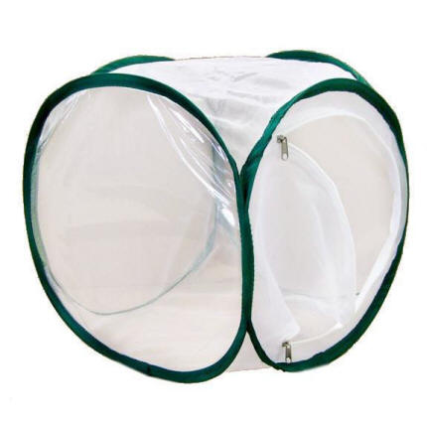
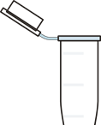
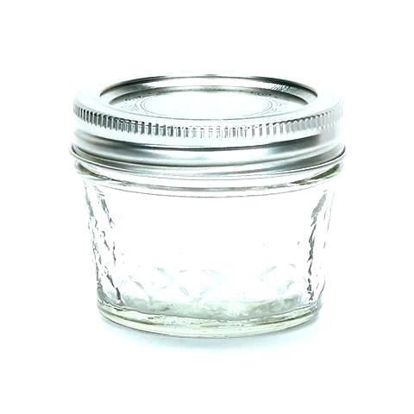
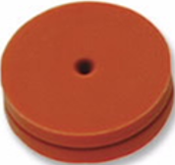
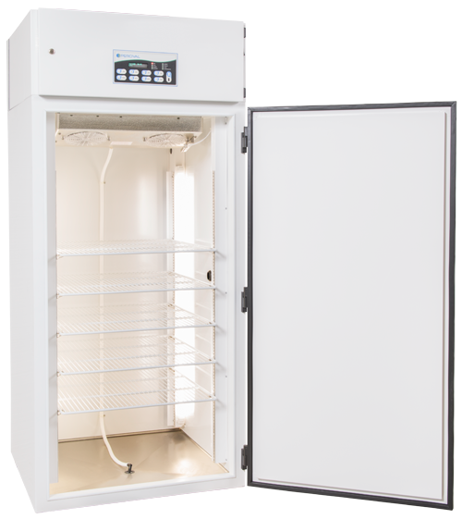
Equipment
Mesh Cages
Trap Jars
4 oz ball jar
Metal lid ring
Teflon lid cover with 2 holes
1 septa covered hole
1 hole plugged with a centrifuge tube
Incubators
25 C, 60% rH, and 16:8 L:D

Slide 6
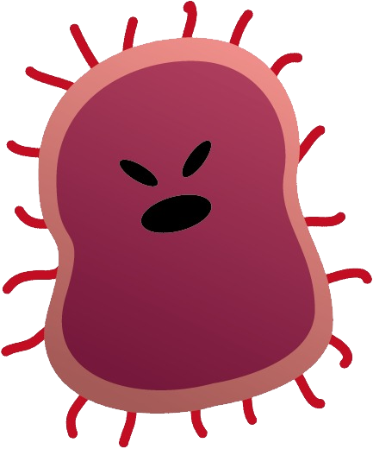
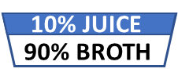
What is in a name?
Blank
Control
Treatment
1 mesh cage
2 empty trap jars
1 mesh cage
2 trap jars
10% juice
90% culture broth
1 mesh cage
2 trap jars
10% juice
90% culture broth
Microbes
10% JUICE
90% BROTH
10% JUICE
90% BROTH

Slide 7
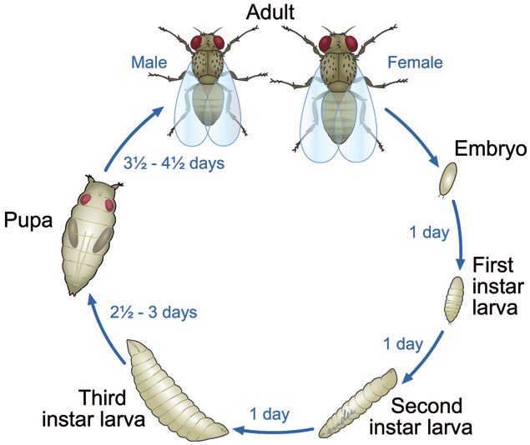
Life Cycle
Stage | Length (days)
Adult | 5
1st instar: | 1
2nd instar: | 1
3rd instar: | 2.5
Wandering: | 0.5
Pupa: | 5

Slide 8
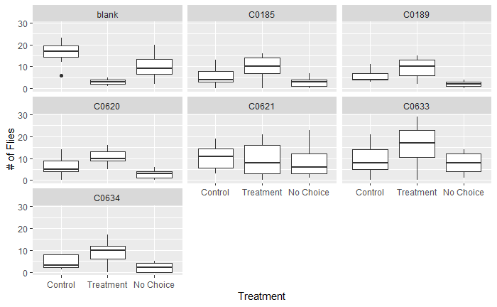

Slide 9
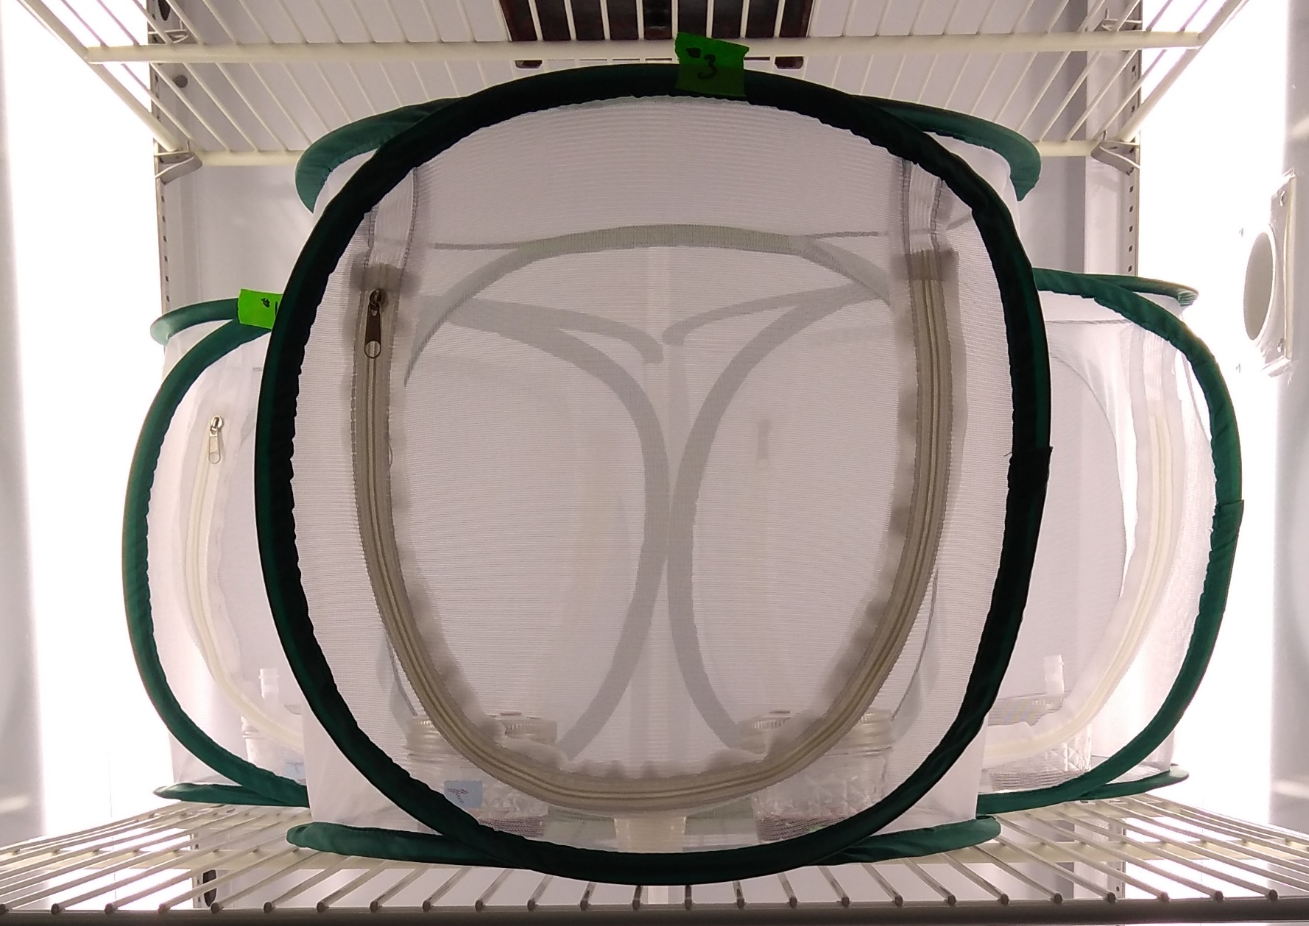

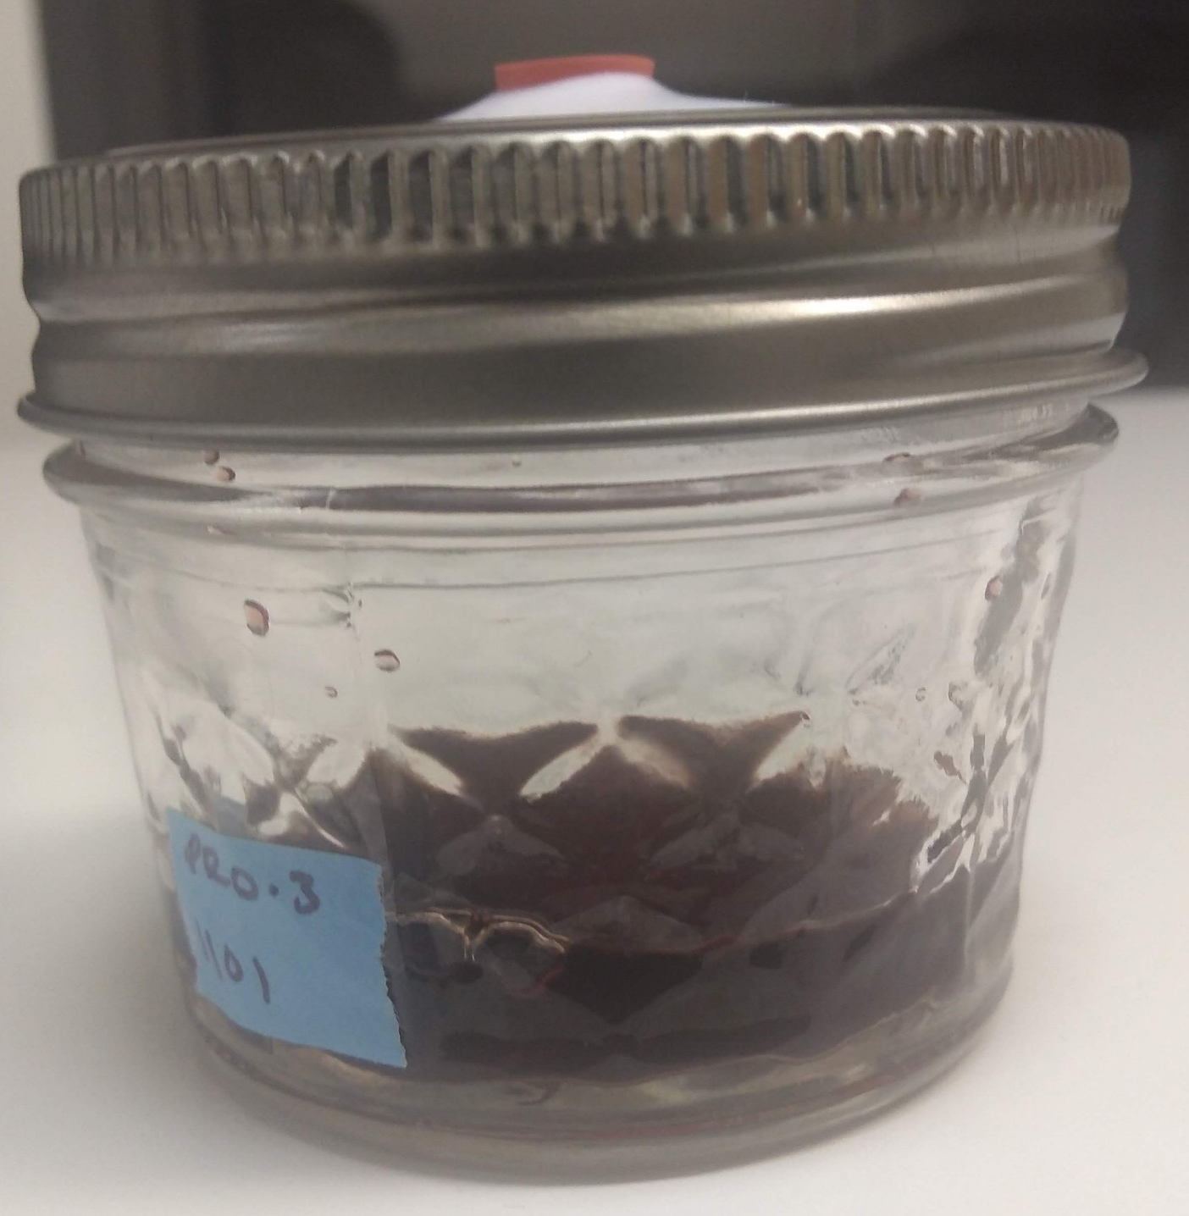
Equipment
Mesh Cages
Trap Jars
4 oz ball jar
Metal lid ring
Teflon lid cover with 2 holes
1 septa covered hole
1 hole plugged with a centrifuge tube
Incubators
25 C, 60% rH, and 16:8 L:D

